Slide 1










2.2 行列式的性质
基本性质总结：
$$\left(1\right) \left|A^{T}\right|=|A|$$
$$\left|A\right|, k=j$$
$$\left(2\right)$$
$$a_{k}^{T}\tilde{a_{j}}=$$
$$0, k≠j$$
$$A=[a_{1},a_{2},⋯{,a}_{j},⋯a_{n}]$$
$$\left(3\right)$$
$$\tilde{a_{j}}=\tilde{b_{j}}$$
$$B=[a_{1},a_{2},⋯{,b}_{j},⋯a_{n}]$$

Slide 2




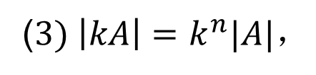


2.2 行列式的性质
行列式的线性性质：
$$A=[a_{1},a_{2},⋯,a_{n}]$$
$则$ 表示$|A|$
$$设$$
$$|a_{1},a_{2},⋯,a_{n}|$$
性质2-3
$$\left(1\right)k|a_{1},⋯,a_{j},⋯,a_{n}|=\left|a_{1},⋯,ka_{j},⋯,a_{n}\right|$$
$$\left(2\right)\left|a_{1},⋯, a_{j},⋯,a_{n}\right|+|a_{1},⋯,b_{j},⋯,a_{n}|$$
$$=\left|a_{1},⋯, a_{j}+b_{j},⋯,a_{n}\right|$$
($3) \left|kA\right|=k^{n}|A|，$
其中$n$为方阵$A$的阶数。

Slide 3

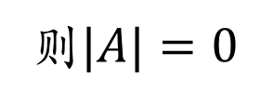
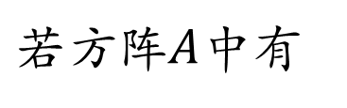
2.2 行列式的性质
行列式为零的矩阵：
某列（行）元素都为零
两列（行）完全相同
则$|A|=0$
$若$方阵$A$中有
两列对应成比例
一列是另外两列之和

Slide 4

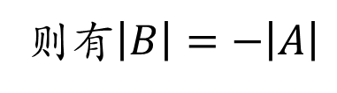


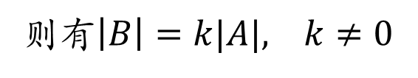


2.2 行列式的性质
初等变换对行列式的作用：
$$kr_{i}$$
（1）倍乘
$$A B$$
则有$\left|B\right|=k|A|, k≠0$
$$或kc_{j}$$
（2）倍加
倍加变换不改变行列式
一次对调
（3）对调
$$A B$$
则有$\left|B\right|=−\left|A\right|$

Slide 5

2.3 行列式的计算

Slide 6
一 基本计算方法

Slide 7
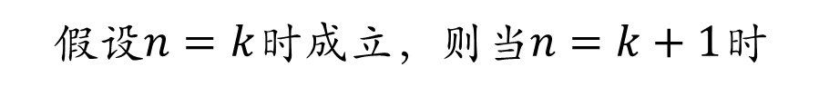




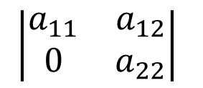
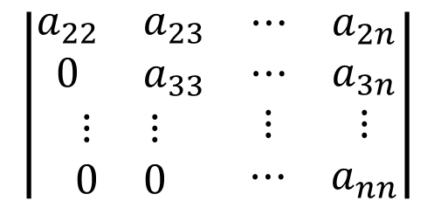

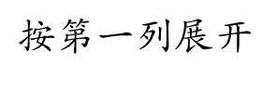

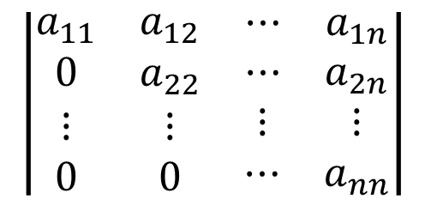

2.3 行列式的计算
下
设$A={\left[a_{ij}\right]}_{n×n}$是上三角矩阵，证明
例2-2
$$\det\left(A\right)=a_{11}a_{22}⋯a_{nn}$$
证明： 数学归纳法
$$当n=2时$$
$$\left|\begin{matrix}a_{11} & a_{12} \\ 0 & a_{22}\end{matrix}\right|$$
$$=a_{11}a_{22}$$
显然成立。
假设$n=k$时成立，则当$n=k+1$时
$k$阶
$$\left|\begin{matrix}\begin{matrix}a_{11} & a_{12} \\ 0 & a_{22}\end{matrix} & \begin{matrix}⋯ & a_{1n} \\ ⋯ & a_{2n}\end{matrix} \\ \begin{matrix}⋮ & ⋮ \\ 0 & 0\end{matrix} & \begin{matrix}⋮ & ⋮ \\ ⋯ & a_{nn}\end{matrix}\end{matrix}\right|$$
$$\left|\begin{matrix}\begin{matrix}a_{22} & a_{23} \\ 0 & a_{33}\end{matrix} & \begin{matrix}⋯ & a_{2n} \\ ⋯ & a_{3n}\end{matrix} \\ \begin{matrix}⋮ & ⋮ \\ 0 & 0\end{matrix} & \begin{matrix}⋮ & ⋮ \\ ⋯ & a_{nn}\end{matrix}\end{matrix}\right|$$
$按$第一列展开
$${{\left(−1\right)}^{1+1}a}_{11}$$
由假设条件可得
$$=a_{11}a_{22}⋯a_{nn}$$

Slide 8
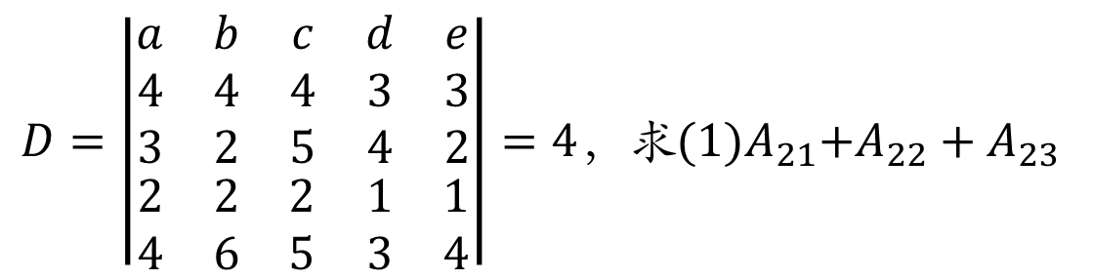

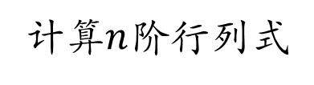


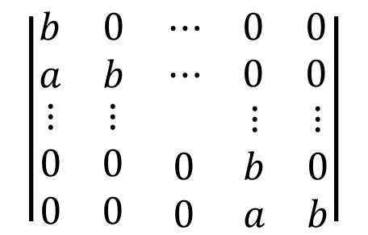


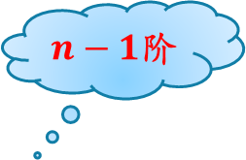
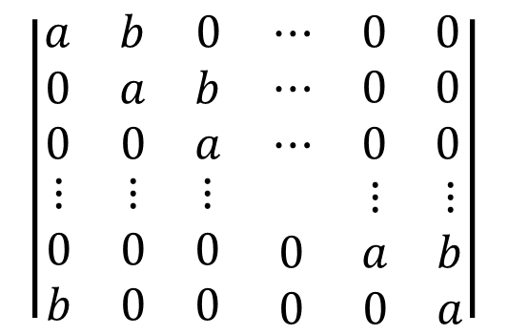
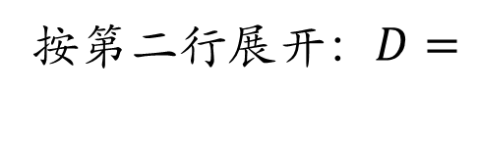

2.3 行列式的计算
1.1 按行列展开
例2-3
计算$n$阶行列式
$$\left|\begin{matrix}\begin{matrix}a & b & 0 \\ 0 & a & b \\ 0 & 0 & a\end{matrix} & \begin{matrix}⋯ & 0 & 0 \\ ⋯ & 0 & 0 \\ ⋯ & 0 & 0\end{matrix} \\ \begin{matrix}⋮ & ⋮ & ⋮ \\ 0 & 0 & 0 \\ b & 0 & 0\end{matrix} & \begin{matrix} & ⋮ & ⋮ \\ 0 & a & b \\ 0 & 0 & a\end{matrix}\end{matrix}\right|$$
$$\left|\begin{matrix}\begin{matrix}a & b & 0 \\ 0 & a & b \\ 0 & 0 & a\end{matrix} & \begin{matrix}⋯ & 0 & 0 \\ ⋯ & 0 & 0 \\ ⋯ & 0 & 0\end{matrix} \\ \begin{matrix}⋮ & ⋮ & ⋮ \\ 0 & 0 & 0 \\ b & 0 & 0\end{matrix} & \begin{matrix} & ⋮ & ⋮ \\ 0 & a & b \\ 0 & 0 & a\end{matrix}\end{matrix}\right|$$
$按$第一列展开
$n−1$阶
$n−1$阶
$$\left|\begin{matrix}\begin{matrix}a & b \\ 0 & a\end{matrix} & \begin{matrix}⋯ & 0 & 0 \\ ⋯ & 0 & 0\end{matrix} \\ \begin{matrix}⋮ & ⋮ \\ 0 & 0 \\ 0 & 0\end{matrix} & \begin{matrix} & ⋮ & ⋮ \\ 0 & a & b \\ 0 & 0 & a\end{matrix}\end{matrix}\right|$$
$$\left|\begin{matrix}\begin{matrix}b & 0 \\ a & b\end{matrix} & \begin{matrix}⋯ & 0 & 0 \\ ⋯ & 0 & 0\end{matrix} \\ \begin{matrix}⋮ & ⋮ \\ 0 & 0 \\ 0 & 0\end{matrix} & \begin{matrix} & ⋮ & ⋮ \\ 0 & b & 0 \\ 0 & a & b\end{matrix}\end{matrix}\right|$$
$${=\left(−1\right)}^{1+1}a$$
$${+\left(−1\right)}^{1+n}b$$
$$=a^{n}$$
$$+{\left(−1\right)}^{n+1}b^{n}$$

Slide 9



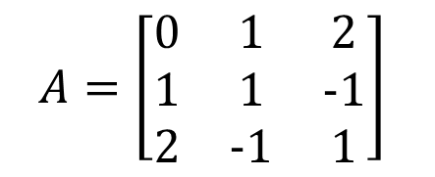
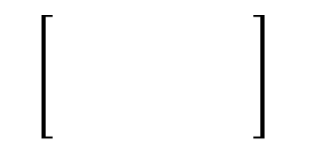









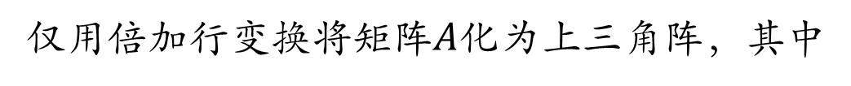


1.3 初等变换与初等阵
例1-11
仅用倍加行变换将矩阵$A$化为上三角阵，其中
$$A=\left[\begin{matrix}0 & 1 & 2 \\ 1 & 1 & −1 \\ 2 & −1 & 1\end{matrix}\right]$$
$$\begin{matrix}1 & 2 & 1\end{matrix}$$
$$+$$
$$\begin{matrix}1 & 2 & 1\end{matrix}$$
$$r_{1}+r_{2}$$
$$\left[\begin{matrix}0 & 1 & 2 \\ 1 & 1 & −1 \\ 2 & −1 & 1\end{matrix}\right]$$
$$r_{2}−r_{1}$$
$$\begin{matrix}0 & −1 & −2\end{matrix}$$
$$r_{3}−2r_{1}$$
$$\begin{matrix}0 & −5 & −1\end{matrix}$$
变换为零
变换为零
变换为零
$$r_{3}−5r_{2}$$
$$\begin{matrix}1 & 2 & 1\end{matrix}$$
$$\begin{matrix}0 & −1 & −2\end{matrix}$$
$$\begin{matrix}0 & 0 & 9\end{matrix}$$
Step1.将首行首列元变换为非零元（一般为1）；
Step2. 依次用每个对角元所在行的若干倍加到其他行上去，使得每列对角元之下的所有元变换为零。
Step2. 用首行的若干倍加到其他行上去，使得首列第一个元之下的所有元变换为零；

Slide 10

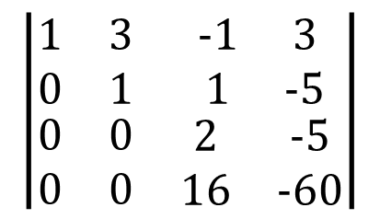
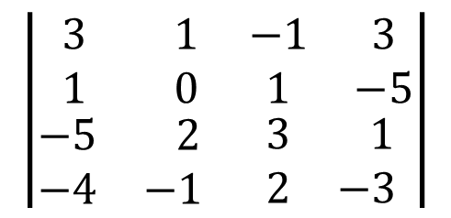
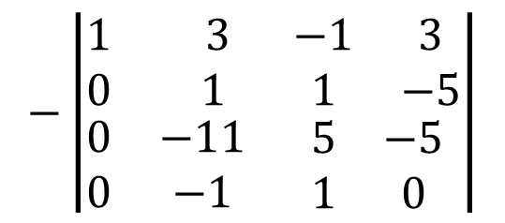




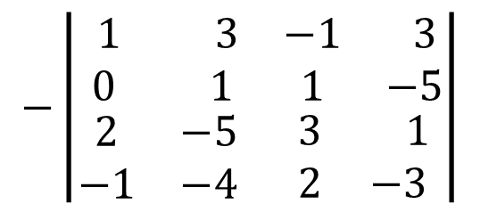
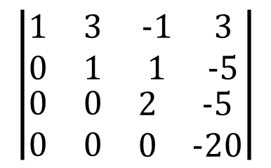
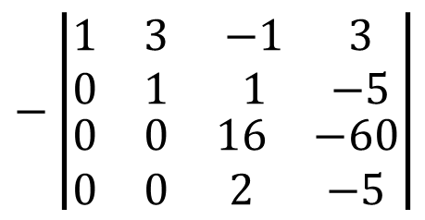



2.3 行列式的计算
1.2 化为三角形
例2-4
计算行列式
$$\left|\begin{matrix}\begin{matrix} 3 & 1 \\ 1 & 0\end{matrix} & \begin{matrix}−1 & 3 \\ 1 & −5\end{matrix} \\ \begin{matrix}−5 & 2 \\ −4 & −1\end{matrix} & \begin{matrix}3 & 1 \\ 2 & −3\end{matrix}\end{matrix}\right|$$
$$−\left|\begin{matrix}\begin{matrix} 1 & 3 \\ 0 & 1\end{matrix} & \begin{matrix}−1 & 3 \\ 1 & −5\end{matrix} \\ \begin{matrix}2 & −5 \\ −1 & −4\end{matrix} & \begin{matrix}3 & 1 \\ 2 & −3\end{matrix}\end{matrix}\right|$$
$$c_{1}↔c_{2}$$
变换为零
$$−\left|\begin{matrix}\begin{matrix}1 & 3 \\ 0 & 1 \end{matrix} & \begin{matrix}−1 & 3 \\ 1 & −5\end{matrix} \\ \begin{matrix}0 & −11 \\ 0 & −1\end{matrix} & \begin{matrix}5 & −5 \\ 1 & 0\end{matrix}\end{matrix}\right|$$
$$−\left|\begin{matrix}\begin{matrix}1 & 3 \\ 0 & 1\end{matrix} & \begin{matrix}−1 & 3 \\ 1 & −5\end{matrix} \\ \begin{matrix}0 & 0 \\ 0 & 0\end{matrix} & \begin{matrix}16 & −60 \\ 2 & −5\end{matrix}\end{matrix}\right|$$
$$r_{3}−2r_{1}$$
$$r_{3}+11r_{2}$$
$$r_{4}+r_{1}$$
$$r_{4}+r_{2}$$
变换为零
变换为零
$$\left|\begin{matrix}\begin{matrix}1 & 3 \\ 0 & 1\end{matrix} & \begin{matrix}−1 & 3 \\ 1 & −5\end{matrix} \\ \begin{matrix}0 & 0 \\ 0 & 0\end{matrix} & \begin{matrix}2 & −5 \\ 16 & −60\end{matrix}\end{matrix}\right|$$
$$\left|\begin{matrix}\begin{matrix}1 & 3 \\ 0 & 1\end{matrix} & \begin{matrix}−1 & 3 \\ 1 & −5\end{matrix} \\ \begin{matrix}0 & 0 \\ 0 & 0\end{matrix} & \begin{matrix}2 & −5 \\ 0 & −20\end{matrix}\end{matrix}\right|$$
$$r_{3}↔r_{4}$$
$$r_{4}−8r_{3}$$
$$=−40$$

Slide 11




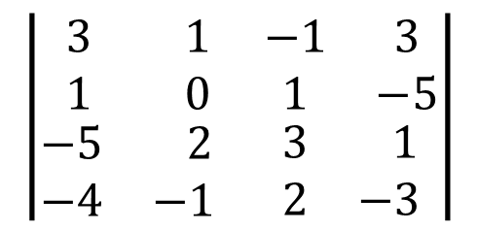
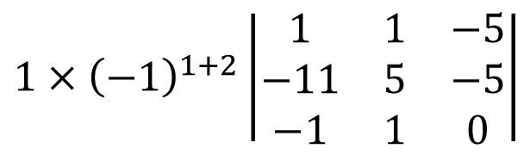
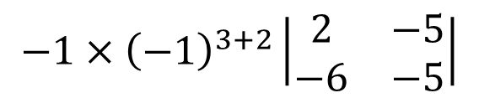


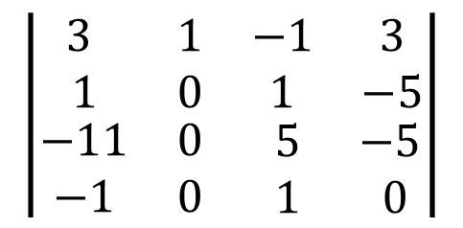
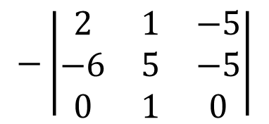
2.3 行列式的计算
1.3 先化简再展开
原则：使得某行（列）多零
例2-5
计算例2-4中行列式
$$\left|\begin{matrix}\begin{matrix} 3 & 1 \\ 1 & 0\end{matrix} & \begin{matrix}−1 & 3 \\ 1 & −5\end{matrix} \\ \begin{matrix}−5 & 2 \\ −4 & −1\end{matrix} & \begin{matrix}3 & 1 \\ 2 & −3\end{matrix}\end{matrix}\right|$$
$$\left|\begin{matrix}\begin{matrix} 3 & 1 \\ 1 & 0\end{matrix} & \begin{matrix}−1 & 3 \\ 1 & −5\end{matrix} \\ \begin{matrix}−11 & 0 \\ −1 & 0\end{matrix} & \begin{matrix} 5 & −5 \\ 1 & 0\end{matrix}\end{matrix}\right|$$
$$r_{3}−2r_{1}$$
$$r_{4}+r_{1}$$
$$1×{\left(−1\right)}^{1+2}\left|\begin{matrix}1 & 1 & −5 \\ −11 & 5 & −5 \\ −1 & 1 & 0\end{matrix}\right|$$
$按$第二列展开
$$−\left|\begin{matrix}2 & 1 & −5 \\ −6 & 5 & −5 \\ 0 & 1 & 0\end{matrix}\right|$$
$$c_{1}+c_{2}$$
$按$第三行展开
$$−1×{\left(−1\right)}^{3+2}\left|\begin{matrix}2 & −5 \\ −6 & −5\end{matrix}\right|$$
$$=−40$$

Slide 12
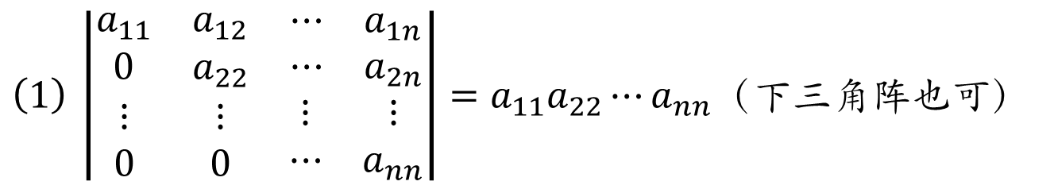
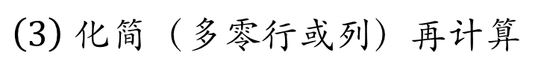
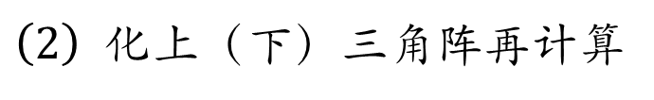
2.3 行列式的计算
一、基本计算方法
$\left(1\right) \left|\begin{matrix}\begin{matrix}a_{11} & a_{12} \\ 0 & a_{22}\end{matrix} & \begin{matrix}⋯ & a_{1n} \\ ⋯ & a_{2n}\end{matrix} \\ \begin{matrix}⋮ & ⋮ \\ 0 & 0\end{matrix} & \begin{matrix}⋮ & ⋮ \\ ⋯ & a_{nn}\end{matrix}\end{matrix}\right|=a_{11}a_{22}⋯a_{nn}$（下三角阵也可）
$\left(2\right)$ 化上（下）三角阵再计算
$\left(3\right)$ 化简（多零行或列）再计算

Slide 13
二 范德蒙行列式

Slide 14
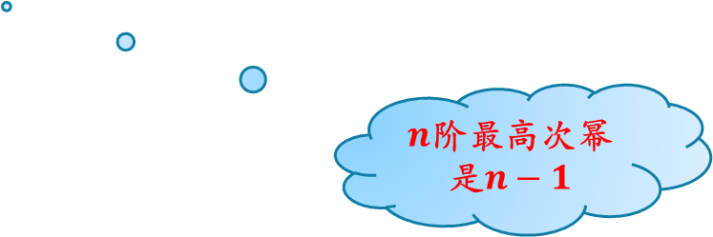

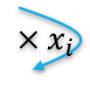
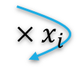


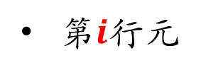
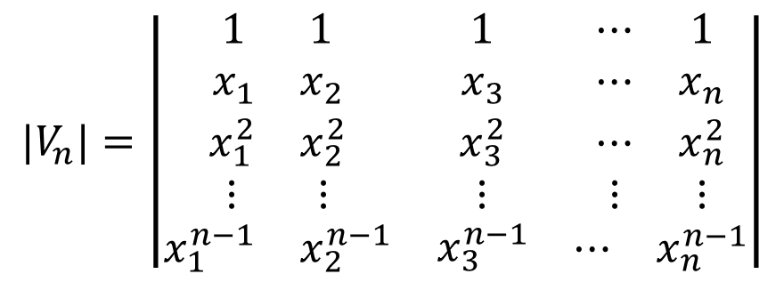
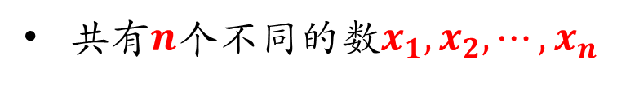
2.3 行列式的计算
$n$阶范德蒙行列式
$$|V_{n}|=\left|\begin{matrix}\begin{matrix}1 & 1 \\ x_{1} & x_{2}\end{matrix} & \begin{matrix}1 \\ x_{3}\end{matrix} & \begin{matrix}⋯ & 1 \\ ⋯ & x_{n}\end{matrix} \\ \begin{matrix}x_{1}^{2} & x_{2}^{2} \\ ⋮ & ⋮\end{matrix} & \begin{matrix}x_{3}^{2} \\ ⋮\end{matrix} & \begin{matrix}⋯ & x_{n}^{2} \\ ⋮ & ⋮\end{matrix} \\ \begin{matrix}x_{1}^{n−1} & x_{2}^{n−1}\end{matrix} & x_{3}^{n−1} & \begin{matrix}⋯ & x_{n}^{n−1}\end{matrix}\end{matrix}\right|$$
$$×x_{i}$$
$$×x_{i}$$
$$×x_{i}$$
$n$阶最高次幂是$n−1$
共有$n$个不同的数$x_{1},x_{2},⋯,x_{n}$
第$i$行元
$$x_{j}^{(i−1)},j=1,2,⋯n$$

Slide 15
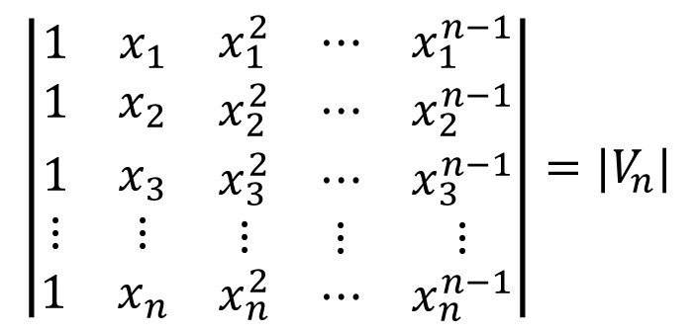

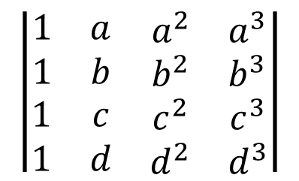
2.3 行列式的计算
$n$阶范德蒙行列式
$$|V_{n}|=\left|\begin{matrix}\begin{matrix}1 & 1 \\ x_{1} & x_{2}\end{matrix} & \begin{matrix}1 \\ x_{3}\end{matrix} & \begin{matrix}⋯ & 1 \\ ⋯ & x_{n}\end{matrix} \\ \begin{matrix}x_{1}^{2} & x_{2}^{2} \\ ⋮ & ⋮\end{matrix} & \begin{matrix}x_{3}^{2} \\ ⋮\end{matrix} & \begin{matrix}⋯ & x_{n}^{2} \\ ⋮ & ⋮\end{matrix} \\ \begin{matrix}x_{1}^{n−1} & x_{2}^{n−1}\end{matrix} & x_{3}^{n−1} & \begin{matrix}⋯ & x_{n}^{n−1}\end{matrix}\end{matrix}\right|$$
$$×x_{i}$$
$$×x_{i}$$
$$×x_{i}$$
$4$阶范德蒙行列式
$$\left|\begin{matrix}\begin{matrix}1 & x_{1} \\ 1 & x_{2}\end{matrix} & \begin{matrix}x_{1}^{2} \\ x_{2}^{2}\end{matrix} & \begin{matrix}⋯ & x_{1}^{n−1} \\ ⋯ & x_{2}^{n−1}\end{matrix} \\ \begin{matrix}1 & x_{3} \\ ⋮ & ⋮\end{matrix} & \begin{matrix}x_{3}^{2} \\ ⋮\end{matrix} & \begin{matrix}⋯ & x_{3}^{n−1} \\ ⋮ & ⋮\end{matrix} \\ \begin{matrix}1 & x_{n}\end{matrix} & x_{n}^{2} & \begin{matrix}⋯ & x_{n}^{n−1}\end{matrix}\end{matrix}\right|={|V}_{n}|$$
$$\left|\begin{matrix}\begin{matrix}1 & a \\ 1 & b\end{matrix} & \begin{matrix}a^{2} & a^{3} \\ b^{2} & b^{3}\end{matrix} \\ \begin{matrix}1 & c \\ 1 & d\end{matrix} & \begin{matrix}c^{2} & c^{3} \\ d^{2} & d^{3}\end{matrix}\end{matrix}\right|$$

Slide 16
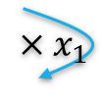






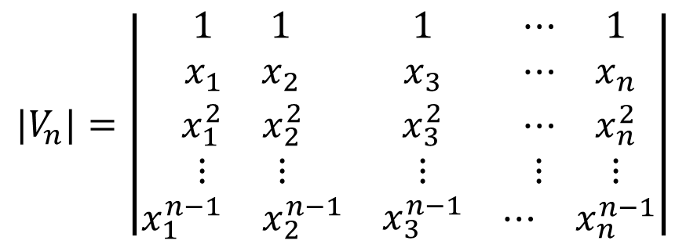
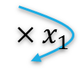
2.3 行列式的计算
$n$阶范德蒙行列式的计算
$${|V}_{n}|=\left|\begin{matrix}\begin{matrix}1 & 1 \\ x_{1} & x_{2}\end{matrix} & \begin{matrix}1 \\ x_{3}\end{matrix} & \begin{matrix}⋯ & 1 \\ ⋯ & x_{n}\end{matrix} \\ \begin{matrix}x_{1}^{2} & x_{2}^{2} \\ ⋮ & ⋮\end{matrix} & \begin{matrix}x_{3}^{2} \\ ⋮\end{matrix} & \begin{matrix}⋯ & x_{n}^{2} \\ ⋮ & ⋮\end{matrix} \\ \begin{matrix}x_{1}^{n−1} & x_{2}^{n−1}\end{matrix} & x_{3}^{n−1} & \begin{matrix}⋯ & x_{n}^{n−1}\end{matrix}\end{matrix}\right|$$
$$×x_{1}$$
$$r_{2}−{x_{1}r}_{1}$$
$$×x_{i}$$
$$×x_{i}$$
$$×x_{1}$$
$$r_{3}−{x_{1}r}_{2}$$
变换为零
$$×x_{i}$$
$$×x_{1}$$
$$r_{n}−{x_{1}r}_{n−1}$$
$$=\left|\begin{matrix}\begin{matrix}1 & 1 \\ 0 & x_{2}−x_{1}\end{matrix} & \begin{matrix}1 \\ x_{3}−x_{1}\end{matrix} & \begin{matrix}⋯ & 1 \\ ⋯ & x_{n}−x_{1}\end{matrix} \\ \begin{matrix} 0 & x_{2}^{2}−x_{2}x_{1} \\ ⋮ & ⋮\end{matrix} & \begin{matrix}x_{3}^{2}−x_{3}x_{1} \\ ⋮\end{matrix} & \begin{matrix}⋯ & x_{n}^{2}−x_{n}x_{1} \\ ⋮ & ⋮\end{matrix} \\ \begin{matrix} 0 & x_{2}^{n−1}−x_{2}^{n−2}x_{1}\end{matrix} & x_{3}^{n−1}−x_{3}^{n−2}x_{1} & \begin{matrix}⋯ & x_{n}^{n−1}−x_{n}^{n−2}x_{1}\end{matrix}\end{matrix}\right|$$

Slide 17


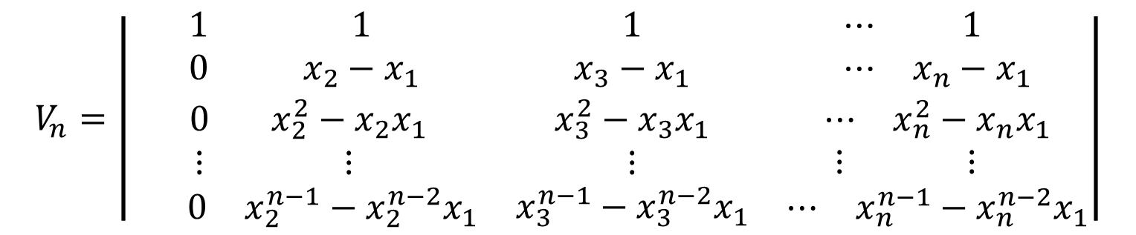
2.3 行列式的计算
$n$阶范德蒙行列式的计算
$$V_{n}=\left|\begin{matrix}\begin{matrix}1 & 1 \\ 0 & x_{2}−x_{1}\end{matrix} & \begin{matrix}1 \\ x_{3}−x_{1}\end{matrix} & \begin{matrix}⋯ & 1 \\ ⋯ & x_{n}−x_{1}\end{matrix} \\ \begin{matrix} 0 & x_{2}^{2}−x_{2}x_{1} \\ ⋮ & ⋮\end{matrix} & \begin{matrix}x_{3}^{2}−x_{3}x_{1} \\ ⋮\end{matrix} & \begin{matrix}⋯ & x_{n}^{2}−x_{n}x_{1} \\ ⋮ & ⋮\end{matrix} \\ \begin{matrix} 0 & x_{2}^{n−1}−x_{2}^{n−2}x_{1}\end{matrix} & x_{3}^{n−1}−x_{3}^{n−2}x_{1} & \begin{matrix}⋯ & x_{n}^{n−1}−x_{n}^{n−2}x_{1}\end{matrix}\end{matrix}\right|$$
$$x_{2}(x_{2}−x_{1})$$
可类似第二列操作
$$x_{2}^{n−2}(x_{2}−x_{1})$$

Slide 18
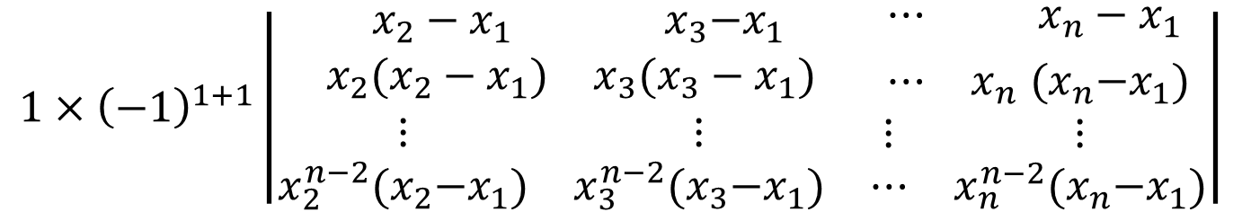

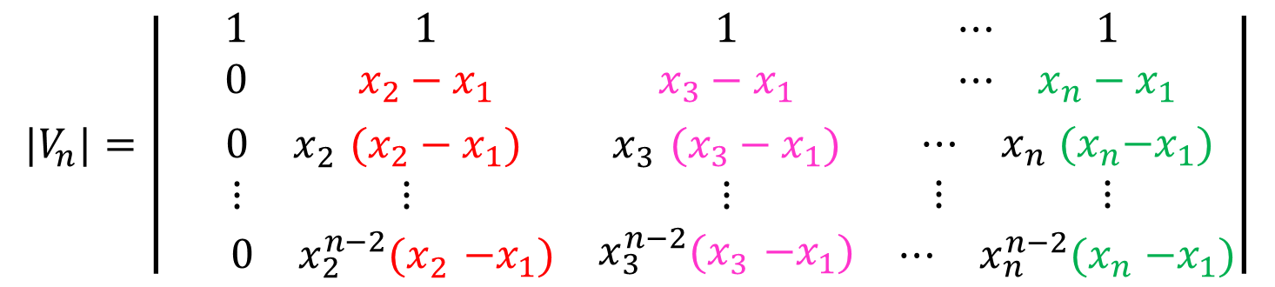
2.3 行列式的计算
$n$阶范德蒙行列式的计算
$${|V}_{n}|=\left|\begin{matrix}\begin{matrix}1 & 1 \\ 0 & x_{2}−x_{1}\end{matrix} & \begin{matrix}1 \\ x_{3}−x_{1}\end{matrix} & \begin{matrix}⋯ & 1 \\ ⋯ & x_{n}−x_{1}\end{matrix} \\ \begin{matrix} 0 & x_{2}^{}(x_{2}−x_{1}) \\ ⋮ & ⋮\end{matrix} & \begin{matrix}x_{3}^{}(x_{3}−x_{1}) \\ ⋮\end{matrix} & \begin{matrix}⋯ & x_{n}^{}{(x}_{n}−x_{1}) \\ ⋮ & ⋮\end{matrix} \\ \begin{matrix} 0 & x_{2}^{n−2}{(x}_{2}^{}−x_{1})\end{matrix} & x_{3}^{n−2}{(x}_{3}^{}−x_{1}) & \begin{matrix}⋯ & x_{n}^{n−2}{(x}_{n}^{}−x_{1})\end{matrix}\end{matrix}\right|$$
$按$第一列展开
$$1×{\left(−1\right)}^{1+1}\left|\begin{matrix}\begin{matrix} x_{2}−x_{1} & { x}_{3}−x_{1} \\ { x}_{2}(x_{2}−x_{1}) & x_{3}(x_{3}−x_{1})\end{matrix} & \begin{matrix}⋯ & x_{n}−x_{1} \\ ⋯ & x_{n}^{}{(x}_{n}−x_{1})\end{matrix} \\ \begin{matrix}⋮ & ⋮ \\ x_{2}^{n−2}{(x}_{2}−x_{1}) & x_{3}^{n−2}{(x}_{3}−x_{1})\end{matrix} & \begin{matrix}⋮ & ⋮ \\ ⋯ & x_{n}^{n−2}{(x}_{n}−x_{1})\end{matrix}\end{matrix}\right|$$

Slide 19




2.3 行列式的计算
$n$阶范德蒙行列式的计算
$$|V_{n}|=\left|\begin{matrix}\begin{matrix} x_{2}−x_{1} & { x}_{3}−x_{1} \\ { x}_{2}(x_{2}−x_{1}) & x_{3}(x_{3}−x_{1})\end{matrix} & \begin{matrix}⋯ & x_{n}−x_{1} \\ ⋯ & x_{n}^{}{(x}_{n}−x_{1})\end{matrix} \\ \begin{matrix}⋮ & ⋮ \\ x_{2}^{n−2}{(x}_{2}−x_{1}) & x_{3}^{n−2}{(x}_{3}−x_{1})\end{matrix} & \begin{matrix}⋮ & ⋮ \\ ⋯ & x_{n}^{n−2}{(x}_{n}−x_{1})\end{matrix}\end{matrix}\right|$$
$$|V_{n}|=\left(x_{2}−x_{1}\right)⋯⋯(x_{n}−x_{1})\left|\begin{matrix}\begin{matrix}1 & 1 \\ x_{2} & x_{3}\end{matrix} & \begin{matrix}1 \\ x_{4}\end{matrix} & \begin{matrix}⋯ & 1 \\ ⋯ & x_{n}\end{matrix} \\ \begin{matrix}x_{2}^{2} & x_{3}^{2} \\ ⋮ & ⋮\end{matrix} & \begin{matrix}x_{4}^{3} \\ ⋮\end{matrix} & \begin{matrix}⋯ & x_{n}^{3} \\ ⋮ & ⋮\end{matrix} \\ \begin{matrix}x_{2}^{n−2} & x_{3}^{n−2}\end{matrix} & x_{4}^{n−2} & \begin{matrix}⋯ & x_{n}^{n−2}\end{matrix}\end{matrix}\right|$$
$$\prod_{i=2}^{n}{(x_{i}−x_{1})}$$
$n−1$阶范德蒙行列式

Slide 20




2.3 行列式的计算
$n$阶范德蒙行列式的计算
$$|V_{n}|=\prod_{i=2}^{n}{(x_{i}−x_{1})}\left|\begin{matrix}\begin{matrix}1 & 1 \\ x_{2} & x_{3}\end{matrix} & \begin{matrix}1 \\ x_{4}\end{matrix} & \begin{matrix}⋯ & 1 \\ ⋯ & x_{n}\end{matrix} \\ \begin{matrix}x_{2}^{2} & x_{3}^{2} \\ ⋮ & ⋮\end{matrix} & \begin{matrix}x_{4}^{3} \\ ⋮\end{matrix} & \begin{matrix}⋯ & x_{n}^{3} \\ ⋮ & ⋮\end{matrix} \\ \begin{matrix}x_{2}^{n−2} & x_{3}^{n−2}\end{matrix} & x_{4}^{n−2} & \begin{matrix}⋯ & x_{n}^{n−2}\end{matrix}\end{matrix}\right|$$
$$=\prod_{i=2}^{n}{\left(x_{i}−x_{1}\right) }\left|\begin{matrix}\begin{matrix}1 & 1 \\ x_{3} & x_{4} \end{matrix} & \begin{matrix}1 \\ x_{5}\end{matrix} & \begin{matrix}⋯ & 1 \\ ⋯ & x_{n}\end{matrix} \\ \begin{matrix}x_{3}^{2} & x_{4}^{2} \\ ⋮ & ⋮\end{matrix} & \begin{matrix}x_{5}^{3} \\ ⋮\end{matrix} & \begin{matrix}⋯ & x_{n}^{3} \\ ⋮ & ⋮\end{matrix} \\ \begin{matrix}x_{3}^{n−3} & x_{4}^{n−3}\end{matrix} & x_{5}^{n−3} & \begin{matrix}⋯ & x_{n}^{n−3}\end{matrix}\end{matrix}\right|$$
$$\prod_{i=3}^{n}{(x_{i}−x_{2})}$$
$n−2$阶范德蒙行列式

Slide 21







2.3 行列式的计算
$n−2$阶范德蒙行列式
$n$阶范德蒙行列式的计算
|$V_{n}|=\prod_{i=2}^{n}{\left(x_{i}−x_{1}\right)\prod_{i=3}^{n}{(x_{i}−x_{2})}}\left|\begin{matrix}\begin{matrix}1 & 1 \\ x_{3} & x_{4} \end{matrix} & \begin{matrix}1 \\ x_{5}\end{matrix} & \begin{matrix}⋯ & 1 \\ ⋯ & x_{n}\end{matrix} \\ \begin{matrix}x_{3}^{2} & x_{4}^{2} \\ ⋮ & ⋮\end{matrix} & \begin{matrix}x_{5}^{3} \\ ⋮\end{matrix} & \begin{matrix}⋯ & x_{n}^{3} \\ ⋮ & ⋮\end{matrix} \\ \begin{matrix}x_{3}^{n−3} & x_{4}^{n−3}\end{matrix} & x_{5}^{n−3} & \begin{matrix}⋯ & x_{n}^{n−3}\end{matrix}\end{matrix}\right|$
$$(x_{n}−x_{n−1} )$$
$$=\prod_{i=2}^{n}{\left(x_{i}−x_{1}\right)⋯⋯\prod_{i=n−1}^{n}{(x_{i}−x_{n−2})}}\left|\begin{matrix}1 & 1 \\ x_{n−1 } & x_{n}\end{matrix}\right|$$
$$\prod_{i=n}^{n}{(x_{i}−x_{n−1})}$$
$$\prod_{j=1}^{n−1}{\left[\prod_{i=j+1}^{n}{(x_{i}−x_{j})}\right]}$$

Slide 22



2.3 行列式的计算
$n$阶范德蒙行列式的计算
$$|V_{n}|=\prod_{j=1}^{n−1}{\left[\prod_{i=j+1}^{n}{(x_{i}−x_{j})}\right]}$$
$$=\prod_{1≤j<i≤n}{(x_{i}−x_{j})}$$
$$det(V_{n})=\prod_{1≤j<i≤n}{(x_{i}−x_{j})}$$

Slide 23











2.3 行列式的计算
可化为范德蒙行列式
$$\left|\begin{matrix}\begin{matrix}a & b \\ a^{2} & b^{2}\end{matrix} & \begin{matrix}c & d \\ c^{2} & { d}^{2}\end{matrix} \\ \begin{matrix}{ a}^{3} & b^{3} \\ 1 & 1\end{matrix} & \begin{matrix}c^{3} & d^{3} \\ 1 & 1 \end{matrix}\end{matrix}\right|$$
$$−\left|\begin{matrix}\begin{matrix}a & b \\ a^{2} & b^{2}\end{matrix} & \begin{matrix}c & d \\ c^{2} & { d}^{2}\end{matrix} \\ \begin{matrix}1 & 1 \\ { a}^{3} & b^{3}\end{matrix} & \begin{matrix}1 & 1 \\ c^{3} & d^{3}\end{matrix}\end{matrix}\right|$$
$$\left|\begin{matrix}\begin{matrix}a & b \\ 1 & 1\end{matrix} & \begin{matrix}c & d \\ 1 & 1\end{matrix} \\ \begin{matrix}a^{2} & b^{2} \\ { a}^{3} & b^{3}\end{matrix} & \begin{matrix}c^{2} & { d}^{2} \\ c^{3} & d^{3}\end{matrix}\end{matrix}\right|$$
$$r_{4}↔r_{3}$$
$$−\left|\begin{matrix}\begin{matrix}1 & 1 \\ a & b\end{matrix} & \begin{matrix}1 & 1 \\ c & d\end{matrix} \\ \begin{matrix}a^{2} & b^{2} \\ a^{3} & b^{3}\end{matrix} & \begin{matrix}c^{2} & d^{2} \\ c^{3} & d^{3}\end{matrix}\end{matrix}\right|$$
$$r_{3}↔r_{2}$$
$$r_{2}↔r_{1}$$
$$=−(b−a)(c−a)(d−a)$$
$$(c−b)(d−b)$$
$$(d−c)$$
逐次对调
保持部分相对位置不变
$$V_{n}=\prod_{1≤j<i≤n}{(x_{i}−x_{j})}$$

Slide 24





2.3 行列式的计算
可化为范德蒙行列式
$$\left|\begin{aligned}\begin{matrix}\begin{matrix}1 & 1 \\ x_{1}+1 & x_{2}+1\end{matrix} & \begin{matrix} ⋯ & 1 \\ ⋯ & x_{n}+1\end{matrix} \\ \begin{matrix}x_{1}^{2}+x_{1} & x_{2}^{2}+x_{2} \\ ⋮ & ⋮\end{matrix} & \begin{matrix}⋯ & x_{n}^{2}+x_{n} \\ ⋮ & ⋮\end{matrix}\end{matrix} \\ \begin{matrix}\begin{matrix}x_{1}^{n−1}+x_{1}^{n−2} & x_{2}^{n−1}+x_{2}^{n−2}\end{matrix} & \begin{matrix}⋯ & x_{n}^{n−1}+x_{n}^{n−2}\end{matrix}\end{matrix}\end{aligned}\right|$$
$$r_{2}−r_{1}$$
$$\begin{matrix}\begin{matrix}x_{1 } & x_{2}\end{matrix} & \begin{matrix} ⋯ & { x}_{n}\end{matrix}\end{matrix}$$
$$\begin{matrix}\begin{matrix}{ x}_{1}^{2} & x_{2}^{2}\end{matrix} & \begin{matrix} ⋯ & x_{n}^{2}\end{matrix}\end{matrix}$$
$$r_{3}−r_{2}$$
$$\begin{matrix}\begin{matrix}{ x}_{1}^{n−1} & x_{2}^{n−1}\end{matrix} & \begin{matrix} ⋯ & x_{n}^{n−1}\end{matrix}\end{matrix}$$
$$r_{n}−r_{n−1}$$
$$=\left|\begin{matrix}\begin{matrix}1 & 1 \\ x_{1} & x_{2}\end{matrix} & \begin{matrix}1 \\ x_{3}\end{matrix} & \begin{matrix}⋯ & 1 \\ ⋯ & x_{n}\end{matrix} \\ \begin{matrix}x_{1}^{2} & x_{2}^{2} \\ ⋮ & ⋮\end{matrix} & \begin{matrix}x_{3}^{3} \\ ⋮\end{matrix} & \begin{matrix}⋯ & x_{n}^{3} \\ ⋮ & ⋮\end{matrix} \\ \begin{matrix}x_{1}^{n−1} & x_{2}^{n−1}\end{matrix} & x_{3}^{n−1} & \begin{matrix}⋯ & x_{n}^{n−1}\end{matrix}\end{matrix}\right|{=V}_{n}$$

Slide 25

2.3 行列式的计算
$n$阶范德蒙行列式的计算
$$det(V_{n})=\prod_{1≤j<i≤n}{(x_{i}−x_{j})}$$
注意：可某些行列式化为范德蒙行列式计算

Slide 26
三 各行（列）之和等于常值

Slide 27








2.3 行列式的计算
例2-7
计算$n$阶行列式
$$\left|\begin{matrix}\begin{matrix}a & b \\ b & a\end{matrix} & \begin{matrix}⋯ & b \\ ⋯ & b\end{matrix} \\ \begin{matrix}⋮ & ⋮ \\ b & b\end{matrix} & \begin{matrix} & ⋮ \\ ⋯ & a \end{matrix}\end{matrix}\right|$$
$$c_{1}+\sum_{i=2}^{n}{c_{i}}$$
$$\left|\begin{matrix}\begin{matrix}a+\left(n−1\right)b & b \\ a+\left(n−1\right)b & a\end{matrix} & \begin{matrix}⋯ & b \\ ⋯ & b\end{matrix} \\ \begin{matrix}⋮ & ⋮ \\ a+\left(n−1\right)b & b\end{matrix} & \begin{matrix} & ⋮ \\ ⋯ & a \end{matrix}\end{matrix}\right|$$
变换为零
变换为零
$$\left|\begin{matrix}\begin{matrix}a+\left(n−1\right)b & b \\ 0 & a−b\end{matrix} & \begin{matrix}⋯ & b \\ ⋯ & 0 \end{matrix} \\ \begin{matrix} ⋮ & ⋮ \\ 0 & 0\end{matrix} & \begin{matrix} & ⋮ \\ ⋯ & a−b \end{matrix}\end{matrix}\right|$$
$$r_{i}−r_{1}$$
$$i=2,3,⋯n$$
$$=\left[a+\left(n−1\right)b\right]{\left(a−b\right)}^{n−1}$$

Slide 28



2.3 行列式的计算
注意：
$$\left|\begin{matrix}\begin{matrix}a & b \\ b & a\end{matrix} & \begin{matrix}⋯ & b \\ ⋯ & b\end{matrix} \\ \begin{matrix}⋮ & ⋮ \\ b & b\end{matrix} & \begin{matrix} & ⋮ \\ ⋯ & a \end{matrix}\end{matrix}\right|$$
各行、列之和都等于常值
所有列加到第一列
$$\left|\begin{matrix}\begin{matrix}1+s & 1 \\ 2 & 2+s\end{matrix} & \begin{matrix}1 \\ 2\end{matrix} & \begin{matrix}⋯ & 1 \\ ⋯ & 2 \end{matrix} \\ \begin{matrix}3 & 3 \\ ⋮ & ⋮\end{matrix} & 3+s & \begin{matrix}⋯ & 3 \\ ⋮ & ⋮ \end{matrix} \\ \begin{matrix}n & n\end{matrix} & n & \begin{matrix} ⋯ & n+s\end{matrix}\end{matrix}\right|$$
各列之和都等于常值
所有行加到第一行

Slide 29







$$\left|\begin{matrix}\begin{matrix}1+s & 1 \\ 2 & 2+s\end{matrix} & \begin{matrix}1 \\ 2\end{matrix} & \begin{matrix}⋯ & 1 \\ ⋯ & 2 \end{matrix} \\ \begin{matrix}3 & 3 \\ ⋮ & ⋮\end{matrix} & 3+s & \begin{matrix}⋯ & 3 \\ ⋮ & ⋮ \end{matrix} \\ \begin{matrix}n & n\end{matrix} & n & \begin{matrix} ⋯ & n+s\end{matrix}\end{matrix}\right|$$
$$r_{1}+\sum_{i=2}^{n}{r_{i}}$$
变换为零
$$\left|\begin{matrix}\begin{matrix}\frac{n\left(n+1\right)}{2}+s & \frac{n\left(n+1\right)}{2}+s \\ 2 & 2+s\end{matrix} & \begin{matrix}\frac{n\left(n+1\right)}{2}+s \\ 2 \end{matrix} & \begin{matrix}⋯ & \frac{n\left(n+1\right)}{2}+s \\ ⋯ & 2 \end{matrix} \\ \begin{matrix}3 & 3 \\ ⋮ & ⋮ \end{matrix} & 3+s & \begin{matrix}⋯ & 3 \\ ⋮ & ⋮ \end{matrix} \\ \begin{matrix}n & n \end{matrix} & n & \begin{matrix} ⋯ & n+s \end{matrix}\end{matrix}\right|$$
下三角阵
$$\left|\begin{matrix}\begin{matrix}s+n\left(n+1\right)/2 & 0 \\ 2 & s\end{matrix} & \begin{matrix}0 \\ 0\end{matrix} & \begin{matrix}⋯ & 0 \\ ⋯ & 0 \end{matrix} \\ \begin{matrix}3 & 0 \\ ⋮ & ⋮\end{matrix} & \begin{aligned}s \\ ⋮\end{aligned} & \begin{matrix}⋯ & 0 \\ ⋮ & ⋮ \end{matrix} \\ \begin{matrix} n & 0\end{matrix} & 0 & \begin{matrix} ⋯ & s \end{matrix} \end{matrix}\right|$$
$$c_{i}−c_{1}$$
$$=\left[\frac{n\left(n+1\right)}{2}+s \right]s^{n−1}$$
$$i=2,3,⋯n$$

Slide 30
四 箭形行列式

Slide 31









2.3 行列式的计算
例2-8
计算$箭形$行列式
$$\left|\begin{matrix}\begin{matrix}x & b_{1} \\ { a}_{1} & d_{1}\end{matrix} & \begin{matrix}b_{2} \\ 0 \end{matrix} & \begin{matrix}⋯ & b_{n} \\ ⋯ & 0\end{matrix} \\ \begin{matrix}a_{2} & 0 \\ ⋮ & ⋮\end{matrix} & \begin{matrix}d_{2} \\ ⋮\end{matrix} & \begin{matrix}⋯ & 0 \\ ⋮ & ⋮\end{matrix} \\ \begin{matrix}a_{n} & 0\end{matrix} & 0 & \begin{matrix}⋯ & d_{n}\end{matrix}\end{matrix}\right|$$
$$c_{1}−{\frac{a_{1}}{d_{1}}c}_{2}$$
$$c_{1}−{\frac{a_{2}}{d_{2}}c}_{3}$$
$$⋯⋯$$
$$c_{1}−{\frac{a_{n}}{d_{n}}c}_{n+1}$$
$$x−\sum_{i=1}^{n}{\frac{a_{i}}{d_{i}}b_{i}}$$
变换为零
=$\left|\begin{matrix}\begin{matrix} x′ & b_{1} \\ 0 & d_{1}\end{matrix} & \begin{matrix}b_{2} \\ 0 \end{matrix} & \begin{matrix}⋯ & b_{n} \\ ⋯ & 0\end{matrix} \\ \begin{matrix}0 & 0 \\ ⋮ & ⋮\end{matrix} & \begin{matrix}d_{2} \\ ⋮\end{matrix} & \begin{matrix}⋯ & 0 \\ ⋮ & ⋮\end{matrix} \\ \begin{matrix}0 & 0\end{matrix} & 0 & \begin{matrix}⋯ & d_{n}\end{matrix}\end{matrix}\right|$
$$=\left(x−\sum_{i=1}^{n}{\frac{a_{i}b_{i}}{d_{i}}}\right)\prod_{i=1}^{n}{d_{i}}$$

Slide 32




2.3 行列式的计算
可化为箭形的行列式
$$\left|\begin{matrix}\begin{matrix}a_{1}+1 & 1 \\ 1 & a_{2}+1\end{matrix} & \begin{matrix}1 \\ 1 \end{matrix} & \begin{matrix}⋯ & 1 \\ ⋯ & 1 \end{matrix} \\ \begin{matrix}1 & 1 \\ ⋮ & ⋮\end{matrix} & \begin{matrix}a_{3}+1 \\ ⋮\end{matrix} & \begin{matrix}⋯ & 1 \\ ⋮ & ⋮ \end{matrix} \\ \begin{matrix}1 & 1\end{matrix} & 1 & \begin{matrix}⋯ & a_{n}+1\end{matrix}\end{matrix}\right|$$
$$r_{i}−r_{1}$$
$$\left|\begin{matrix}\begin{matrix}a_{1}+1 & 1 \\ −a_{1} & a_{2}\end{matrix} & \begin{matrix}1 \\ 0 \end{matrix} & \begin{matrix}⋯ & 1 \\ ⋯ & 0 \end{matrix} \\ \begin{matrix}−a_{1} & 0 \\ ⋮ & ⋮\end{matrix} & \begin{matrix}a_{3} \\ ⋮\end{matrix} & \begin{matrix}⋯ & 0 \\ ⋮ & ⋮ \end{matrix} \\ \begin{matrix}−a_{1} & 0\end{matrix} & 0 & \begin{matrix}⋯ & a_{n}0\end{matrix}\end{matrix}\right|$$
$$i=2,3,⋯n$$

Slide 33











2.3 行列式的计算
递推法及三对角行列式
$$\left|\begin{matrix}\begin{matrix}5 & 3 & 0 \\ 2 & 5 & 3 \\ 0 & 2 & 5\end{matrix} & \begin{matrix}⋯ & 0 & 0 \\ ⋯ & 0 & 0 \\ ⋯ & 0 & 0\end{matrix} \\ \begin{matrix}⋮ & ⋮ & ⋮ \\ 0 & 0 & 0 \\ 0 & 0 & 0\end{matrix} & \begin{matrix} & ⋮ & ⋮ \\ ⋯ & 5 & 3 \\ ⋯ & 2 & 5\end{matrix}\end{matrix}\right|$$
$$D_{n}=$$
$按$第一列展开
$${5×{\left(−1\right)}^{1+1}D}_{n−1}+$$
$$n−1阶$$
$$\left|\begin{matrix}\begin{matrix}3 & 0 & 0 \\ 2 & 5 & 3 \\ 0 & 2 & 5\end{matrix} & \begin{matrix}⋯ & 0 & 0 \\ ⋯ & 0 & 0 \\ ⋯ & 0 & 0\end{matrix} \\ \begin{matrix}⋮ & ⋮ & ⋮ \\ 0 & 0 & 0 \\ 0 & 0 & 0\end{matrix} & \begin{matrix} & ⋮ & ⋮ \\ ⋯ & 5 & 3 \\ ⋯ & 2 & 5\end{matrix}\end{matrix}\right|$$
$$D_{n−1}$$
$$2×{\left(−1\right)}^{1+2}$$
$$×3D_{n−2}$$
$$D_{n}=5D_{n−1}−6D_{n−2}$$
$$n−2阶D_{n−2}$$

Slide 34















2.3 行列式的计算
递推法及三对角行列式
$$D_{n}=5D_{n−1}−6D_{n−2}$$
$$=3D_{n−1}+2D_{n−1}−6D_{n−2}$$
$$D_{n}=3^{n}+2D_{n−1}$$
$$D_{n}−2D_{n−1}=3D_{n−1}−6D_{n−2}$$
$=3(D_{n−1}−2D_{n−2}$)
$$D_{n}−2D_{n−1}$$
$=3×3(D_{n−2}−2D_{n−3}$)
$$3D_{n−1}+2D_{n−1}$$
$$=⋯⋯$$
$=3^{n−2}(D_{2}−2D_{1}$)
$$=3^{n−2}×(19−2×5)$$
$$=3^{n}$$
$$D_{2}=\left|\begin{matrix}5 & 3 \\ 2 & 5\end{matrix}\right|$$
$$=25−6=19$$
$$D_{1}=5$$

Slide 35











2.3 行列式的计算
递推法及三对角行列式
$$(1)$$
$$D_{n}=3^{n}+2D_{n−1}$$
$$(2)$$
$$D_{n}=2^{n}+3D_{n−1}$$
$$D_{n}=5D_{n−1}−6D_{n−2}$$
$$=3D_{n−1}+2D_{n−1}−6D_{n−2}$$
$$D_{n}−3D_{n−1}=2D_{n−1}−6D_{n−2}$$
$=2(D_{n−1}−3D_{n−2}$)
$\left(1\right)−(2)$可得
$$3^{n}−2^{n}−D_{n−1}=0$$
$$D_{n−1}=3^{n}−2^{n}$$
$$D_{n}=3^{n+1}−2^{n+1}$$

Slide 36







2.3 行列式的计算
递推法及三对角行列式
$$\left|\begin{matrix}\begin{matrix}a & b & 0 \\ c & a & b \\ 0 & c & a\end{matrix} & \begin{matrix}⋯ & 0 & 0 \\ ⋯ & 0 & 0 \\ ⋯ & 0 & 0\end{matrix} \\ \begin{matrix}⋮ & ⋮ & ⋮ \\ 0 & 0 & 0 \\ 0 & 0 & 0\end{matrix} & \begin{matrix} & ⋮ & ⋮ \\ ⋯ & a & b \\ ⋯ & c & a\end{matrix}\end{matrix}\right|$$
$$=\left\{\begin{aligned}\left(n+1\right)x_{1}^{n}, x_{1}=x_{2} \\ \\ \frac{x_{1}^{n+1}−x_{2}^{n+1}}{x_{1}−x_{2}}, x_{1}≠x_{2}\end{aligned}\right.$$
$$D_{n}=$$
$其中x_{1},x_{2} 是 x^{2}−ax+bc=0 的$两个根
$即x_{1}+x_{2}=a ,$ $x_{1}x_{2}=bc$
$a=5 ,$ $b=3,c=2$
$2+3=a ,$ $2×3=bc$

Slide 37

知识点总结
2.3 行列式计算
基本计算方法
按行列展开 化为三角形 先化简再展开
范德蒙行列式
各行（列）之和为常值
箭形行列式
递推法及三对角行列式

Slide 38
2.3 行列式计算
作业：
习题2-3：
1. (3)(8)(9)(12) 2. (2)(5)(6) 3
思考：
提高题2-3：1.

Slide 39









2.3 行列式的计算
反对角的行列式计算
中间的列不用调换
$$\left|\begin{matrix}\begin{matrix}0 & 0 \\ 0 & 0\end{matrix} & \begin{aligned}⋯ \\ ⋯ \end{aligned} & \begin{matrix}0 & 1 \\ 2 & 0 \end{matrix} \\ \begin{matrix}⋮ & ⋮ \\ 0 & n−1\end{matrix} & \begin{matrix} \\ ⋯\end{matrix} & \begin{matrix}⋮ & ⋮ \\ 0 & 0 \end{matrix} \\ \begin{matrix}n & 0\end{matrix} & ⋯ & 0 0 \end{matrix}\right|$$
$$={\left(−1\right)}^{\left[\frac{n}{2}\right]}n!$$
下取整
Case 1) 当$n$是偶数
Case 2) 当$n$是奇数
$${\left(−1\right)}^{[\frac{n}{2}]}n!$$
$${\left(−1\right)}^{\frac{n−1}{2}}n!$$
$${\left(−1\right)}^{n/2}n!$$
统一形式
$n/2次$对调
$(n−1)/2次$对调

Slide 40




2.3 行列式的计算
反对角的行列式计算
$$\left|\begin{matrix}\begin{matrix}0 & 0 \\ 0 & 0\end{matrix} & \begin{aligned}⋯ \\ ⋯ \end{aligned} & \begin{matrix}0 & 1 \\ 2 & 0 \end{matrix} \\ \begin{matrix}⋮ & ⋮ \\ 0 & n−1\end{matrix} & \begin{matrix} \\ ⋯\end{matrix} & \begin{matrix}⋮ & ⋮ \\ 0 & 0 \end{matrix} \\ \begin{matrix}n & 0\end{matrix} & ⋯ & 0 0 \end{matrix}\right|$$
逐次对角
$$\left|\begin{matrix}\begin{matrix}n & 0 \\ 0 & 0\end{matrix} & \begin{aligned}⋯ \\ ⋯ \end{aligned} & \begin{matrix}0 & 0 \\ 0 & 1 \end{matrix} \\ \begin{matrix}⋮ & ⋮ \\ 0 & 0\end{matrix} & \begin{matrix} \\ ⋯\end{matrix} & \begin{matrix}⋮ & ⋮ \\ 0 & 0 \end{matrix} \\ \begin{matrix} 0 & n−1\end{matrix} & ⋯ & 0 0 \end{matrix}\right|$$
$$r_{i−1}↔r_{i}$$
$${\left(−1\right)}^{n−1}$$
$$i=n,n−1, ⋯2$$
$n−1次$对调

Slide 41


2.3 行列式的计算
反对角的行列式计算
$$\left|\begin{matrix}\begin{matrix}n & 0 \\ 0 & 0\end{matrix} & \begin{aligned}⋯ \\ ⋯ \end{aligned} & \begin{matrix}0 & 0 \\ 0 & 1 \end{matrix} \\ \begin{matrix}⋮ & ⋮ \\ 0 & 0\end{matrix} & \begin{matrix} \\ ⋯\end{matrix} & \begin{matrix}⋮ & ⋮ \\ 0 & 0 \end{matrix} \\ \begin{matrix} 0 & n−1\end{matrix} & ⋯ & 0 0 \end{matrix}\right|$$
逐次对角
$$r_{i−1}↔r_{i}$$
$$\left|\begin{matrix}\begin{matrix} n & 0 \\ 0 & n−1\end{matrix} & \begin{aligned}0 \\ 0 \end{aligned} & \begin{matrix}⋯ & 0 \\ ⋯ & 0 \end{matrix} \\ \begin{matrix}0 & 0 \\ ⋮ & ⋮\end{matrix} & \begin{matrix} 0 \\ ⋮\end{matrix} & \begin{matrix}⋯ & 1 \\ ⋮ & ⋮ \end{matrix} \\ \begin{matrix}0 & 0\end{matrix} & n−2 & ⋯ 0 \end{matrix}\right|$$
$${\left(−1\right)}^{n−2}$$
$$i=n,n−1, ⋯3$$
$n−2次$对调

Slide 42







2.3 行列式的计算
反对角的行列式计算
$$\left|\begin{matrix}\begin{matrix}0 & 0 \\ 0 & 0\end{matrix} & \begin{aligned}⋯ \\ ⋯ \end{aligned} & \begin{matrix}0 & 1 \\ 2 & 0 \end{matrix} \\ \begin{matrix}⋮ & ⋮ \\ 0 & n−1\end{matrix} & \begin{matrix} \\ ⋯\end{matrix} & \begin{matrix}⋮ & ⋮ \\ 0 & 0 \end{matrix} \\ \begin{matrix}n & 0\end{matrix} & ⋯ & 0 0 \end{matrix}\right|$$
逐次对角
$$=\frac{\left(n−1\right)n}{2}次$$
$$(n−1)$$
$$+(n−2)$$
$$+⋯+1次$$
$$\left|\begin{matrix}\begin{matrix}n & 0 \\ 0 & n−1\end{matrix} & \begin{aligned}⋯ \\ ⋯ \end{aligned} & \begin{matrix}0 & 0 \\ 0 & 0\end{matrix} \\ \begin{matrix}⋮ & ⋮ \\ 0 & 0\end{matrix} & \begin{matrix} \\ ⋯\end{matrix} & \begin{matrix}⋮ & ⋮ \\ 2 & 0\end{matrix} \\ \begin{matrix} 0 & 0\end{matrix} & ⋯ & 0 1\end{matrix}\right|$$
$${\left(−1\right)}^{\frac{\left(n−1\right)n}{2}}$$

Slide 43




2.3 行列式的计算
反对角的行列式计算
逐次对角
$$\left|\begin{matrix}\begin{matrix}0 & 0 \\ 0 & 0\end{matrix} & \begin{aligned}⋯ \\ ⋯ \end{aligned} & \begin{matrix}0 & 1 \\ 2 & 0 \end{matrix} \\ \begin{matrix}⋮ & ⋮ \\ 0 & n−1\end{matrix} & \begin{matrix} \\ ⋯\end{matrix} & \begin{matrix}⋮ & ⋮ \\ 0 & 0 \end{matrix} \\ \begin{matrix}n & 0\end{matrix} & ⋯ & 0 0 \end{matrix}\right|$$
$${=\left(−1\right)}^{\frac{\left(n−1\right)n}{2}}n!$$
$$={\left(−1\right)}^{\left[\frac{n}{2}\right]}n!$$
分奇偶讨论
$$\frac{\left(n−1\right)n}{2}≠\left[\frac{n}{2}\right]$$
但奇偶一致

Slide 44



1.3 初等变换与初等阵
图片素材

Slide 45







2.3 行列式的计算
反对角的行列式计算
$$\frac{\left(n−1\right)n}{2}≠\left[\frac{n}{2}\right]$$
但奇偶一致
以奇数为例讨论：$\frac{\left(n−1\right)n}{2}奇数⇒\left[\frac{n}{2}\right]奇数$
$$\frac{\left(n−1\right)n}{2}=2k+1$$
$\left(n−1\right)$是奇数
$n/2$必为奇数
$n$是奇数
$\left(n−1\right)/2$必为奇数

Slide 46











2.3 行列式的计算
反对角的行列式计算
$$\frac{\left(n−1\right)n}{2}奇数⇒\left[\frac{n}{2}\right]奇数$$
$$\frac{\left(n−1\right)n}{2}=2k+1$$
Case 1) 当$n$是偶数
$\left(n−1\right)$是奇数
$n/2$必为奇数
Case 2) 当$n$是奇数
$n$是奇数
$\left(n−1\right)/2$必为奇数
Case 1) 当$n$是偶数
Case 2) 当$n$是奇数
$$={\left(−1\right)}^{\left[\frac{n}{2}\right]}=$$
$${\left(−1\right)}^{\frac{n−1}{2}}$$
$${\left(−1\right)}^{n/2}$$
$n/2次$对调
$(n−1)/2次$对调

Slide 47







2.3 行列式的计算
递推法及三对角行列式
$$\left|\begin{matrix}\begin{matrix}a & b & 0 \\ c & a & b \\ 0 & c & a\end{matrix} & \begin{matrix}⋯ & 0 & 0 \\ ⋯ & 0 & 0 \\ ⋯ & 0 & 0\end{matrix} \\ \begin{matrix}⋮ & ⋮ & ⋮ \\ 0 & 0 & 0 \\ 0 & 0 & 0\end{matrix} & \begin{matrix} & ⋮ & ⋮ \\ ⋯ & a & b \\ ⋯ & c & a\end{matrix}\end{matrix}\right|$$
$$D_{n}=$$
$按$第一列展开
$${a×{\left(−1\right)}^{1+1}D}_{n−1}+$$
$$n−1阶$$
$$\left|\begin{matrix}\begin{matrix}b & 0 & 0 \\ c & a & b \\ 0 & c & a\end{matrix} & \begin{matrix}⋯ & 0 & 0 \\ ⋯ & 0 & 0 \\ ⋯ & 0 & 0\end{matrix} \\ \begin{matrix}⋮ & ⋮ & ⋮ \\ 0 & 0 & 0 \\ 0 & 0 & 0\end{matrix} & \begin{matrix} & ⋮ & ⋮ \\ ⋯ & a & b \\ ⋯ & c & a\end{matrix}\end{matrix}\right|$$
$$D_{n−1}$$
$$c×{\left(−1\right)}^{1+2}$$
$$×bD_{n−2}$$
$$D_{n}=aD_{n−1}−bcD_{n−2}$$
$$n−2阶D_{n−2}$$

Slide 48














2.3 行列式的计算
递推法及三对角行列式
$$D_{n}=x_{2}^{n}+x_{1}D_{n−1}$$
$$D_{n}=aD_{n−1}−bcD_{n−2}$$
$$=x_{1}D_{n−1}+x_{2}D_{n−1}−x_{1}x_{2}D_{n−2}$$
$$D_{n}−x_{1}D_{n−1}$$
$=x_{2}(D_{n−1}−x_{1}D_{n−2}$)
$$D_{n}−x_{1}D_{n−1}=x_{2}D_{n−1}−x_{1}x_{2}D_{n−2}$$
$=x_{2}×x_{2}(D_{n−2}−x_{1}D_{n−3}$)
$$a=x_{1}+x_{2}$$
$$b=x_{1}x_{2}$$
$$=⋯⋯$$
$=x_{2}^{n−2}(D_{2}−x_{1}D_{1}$)
$$=x_{2}^{n−2}×(x_{1}^{2}+x_{2}^{2}+x_{1}x_{2}−x_{1}(x_{1}+x_{2}))$$
$$=x_{2}^{n}$$
$$D_{2}=\left|\begin{matrix}a & b \\ c & a\end{matrix}\right|$$
$$=x_{1}^{2}+x_{2}^{2}+2x_{1}x_{2}−x_{1}x_{2}$$
$$=a^{2}−bc$$
$=x_{1}^{2}+x_{2}^{2}+x_{1}x_{2}$
$$D_{1}=a=x_{1}+x_{2}$$

Slide 49







2.3 行列式的计算
递推法及三对角行列式
$$(1)$$
$$D_{n}=x_{2}^{n}+x_{1}D_{n−1}$$
$$(2)$$
$$D_{n}=x_{1}^{n}+x_{2}D_{n−1}$$
$$D_{n}=aD_{n−1}−bcD_{n−2}$$
$\left(1\right)−(2)$可得
$$D_{n−1}=\frac{x_{2}^{n}−x_{1}^{n}}{x_{2}−x_{1}}$$
$$x_{2}^{n}−x_{1}^{n}−(x_{1}−x_{2})D_{n−1}=0$$
$$D_{n}=\frac{x_{2}^{n+1}−x_{1}^{n+1}}{x_{2}−x_{1}}$$

Slide 50










2.3 行列式的计算
递推法及三对角行列式
$$D_{n}=x_{2}^{n}+x_{1}D_{n−1}$$
$x_{1}=x_{2}$
$$D_{n}=aD_{n−1}−bcD_{n−2}$$
$$D_{1}=a=x_{1}+x_{2}$$
$$D_{n}=x_{1}^{n}+$$
$x_{1}×(x_{1}^{n−1}+x_{1}D_{n−2}$)
$$=x_{1}^{n}+x_{1}^{n}+x_{1}^{2}D_{n−2}$$
$$=2x_{1}^{n}+x_{1}^{2}D_{n−2}$$
$$=⋯⋯$$
$$=\left(n−1\right)x_{1}^{n}+x_{1}^{n−1}D_{1}$$
$$=\left(n−1\right)x_{1}^{n}+2x_{1}^{n}$$
$$=\left(n+1\right)x_{1}^{n}$$

Slide 51
2.3 行列式的计算
递推法及三对角行列式
$$\left|\begin{matrix}\begin{matrix}a & b & 0 \\ c & a & b \\ 0 & c & a\end{matrix} & \begin{matrix}⋯ & 0 & 0 \\ ⋯ & 0 & 0 \\ ⋯ & 0 & 0\end{matrix} \\ \begin{matrix}⋮ & ⋮ & ⋮ \\ 0 & 0 & 0 \\ 0 & 0 & 0\end{matrix} & \begin{matrix} & ⋮ & ⋮ \\ ⋯ & a & b \\ ⋯ & c & a\end{matrix}\end{matrix}\right|$$
$$=\left\{\begin{aligned}\left(n+1\right)x_{1}^{n}, x_{1}=x_{2} \\ \\ \frac{x_{1}^{n+1}−x_{2}^{n+1}}{x_{1}−x_{2}}, x_{1}≠x_{2}\end{aligned}\right.$$
$$D_{n}=$$
$其中x_{1},x_{2} 是 x^{2}−ax+bc=0 的$两个根
$即x_{1}+x_{2}=a ,$ $x_{1}x_{2}=bc$
$a=5 ,$ $b=3,c=2$
$2+3=a ,$ $2×3=bc$

Slide 52

1.3 初等变换与初等阵
图片素材

Slide 53


2.2 行列式的性质
提高题5.
$$D=\left|\begin{matrix}\begin{matrix}a & b & c \\ 4 & 4 & 4 \\ 3 & 2 & 5\end{matrix} & \begin{matrix}d & e \\ 3 & 3 \\ 4 & 2\end{matrix} \\ \begin{matrix}2 & 2 & 2 \\ 4 & 6 & 5\end{matrix} & \begin{matrix}1 & 1 \\ 3 & 4\end{matrix}\end{matrix}\right|=4，求{(1)A}_{21}+A_{22}+A_{23}$$
已知行列式
$${(2)A}_{31}+A_{32}+A_{33}$$
按第二行展开$：D=$
4$A_{21}+{4A}_{22}+{4A}_{23}+3A_{24}+3A_{25}$
设$A_{21}+A_{22}+A_{23}=X,$
$$A_{24}+A_{25}=Y$$
$$\left\{\begin{aligned}4X+3Y=4 \\ 2X+Y=0\end{aligned}\right.$$
$$X=−2$$
$$Y=4$$
类似$可得：A_{31}+A_{32}+A_{33}=0$

Slide 54











2.3 行列式的计算
递推法及三对角行列式
$$D_{n}=3^{n}+2D_{n−1}$$
$${2D}_{n−1}$$
$$D_{1}=5$$
$$=3+2$$
$$D_{n}=3^{n}+$$
$2×(3^{n−1}+2D_{n−2}$)
$${2^{n−1}D}_{1}=2^{n−1}(3+2)$$
$$=3^{n}+2×3^{n−1}+2^{2}D_{n−2}$$
$${2^{2}D}_{n−2}$$
$$=3^{n}+2×3^{n−1}+2^{2}(3^{n−2}+2D_{n−3})$$
$$=⋯⋯$$
$$=3^{n}+2×3^{n−1}+⋯+2^{n−2}×{(3}^{2}+2D_{1})$$
$$=3^{n}+2×3^{n−1}+2^{2}×3^{n−2}+⋯+2^{n−1}×3+2^{n}$$

Slide 55





2.3 行列式的计算
递推法及三对角行列式
$$D_{n}=3^{n}+2×3^{n−1}+2^{2}×3^{n−2}+⋯+2^{n−1}×3+2^{n}$$
$$=q_{0}+q_{1}+⋯+q_{n}$$
$$=q_{0}\frac{1−{\left(\frac{2}{3}\right)}^{n+1}}{1−\frac{2}{3}}$$
$$=3^{n+1}−2^{n+1}$$
$$q_{k}=3^{n}{\left(\frac{2}{3}\right)}^{k}$$
$$q_{0}=3^{n}$$

